Slide 1
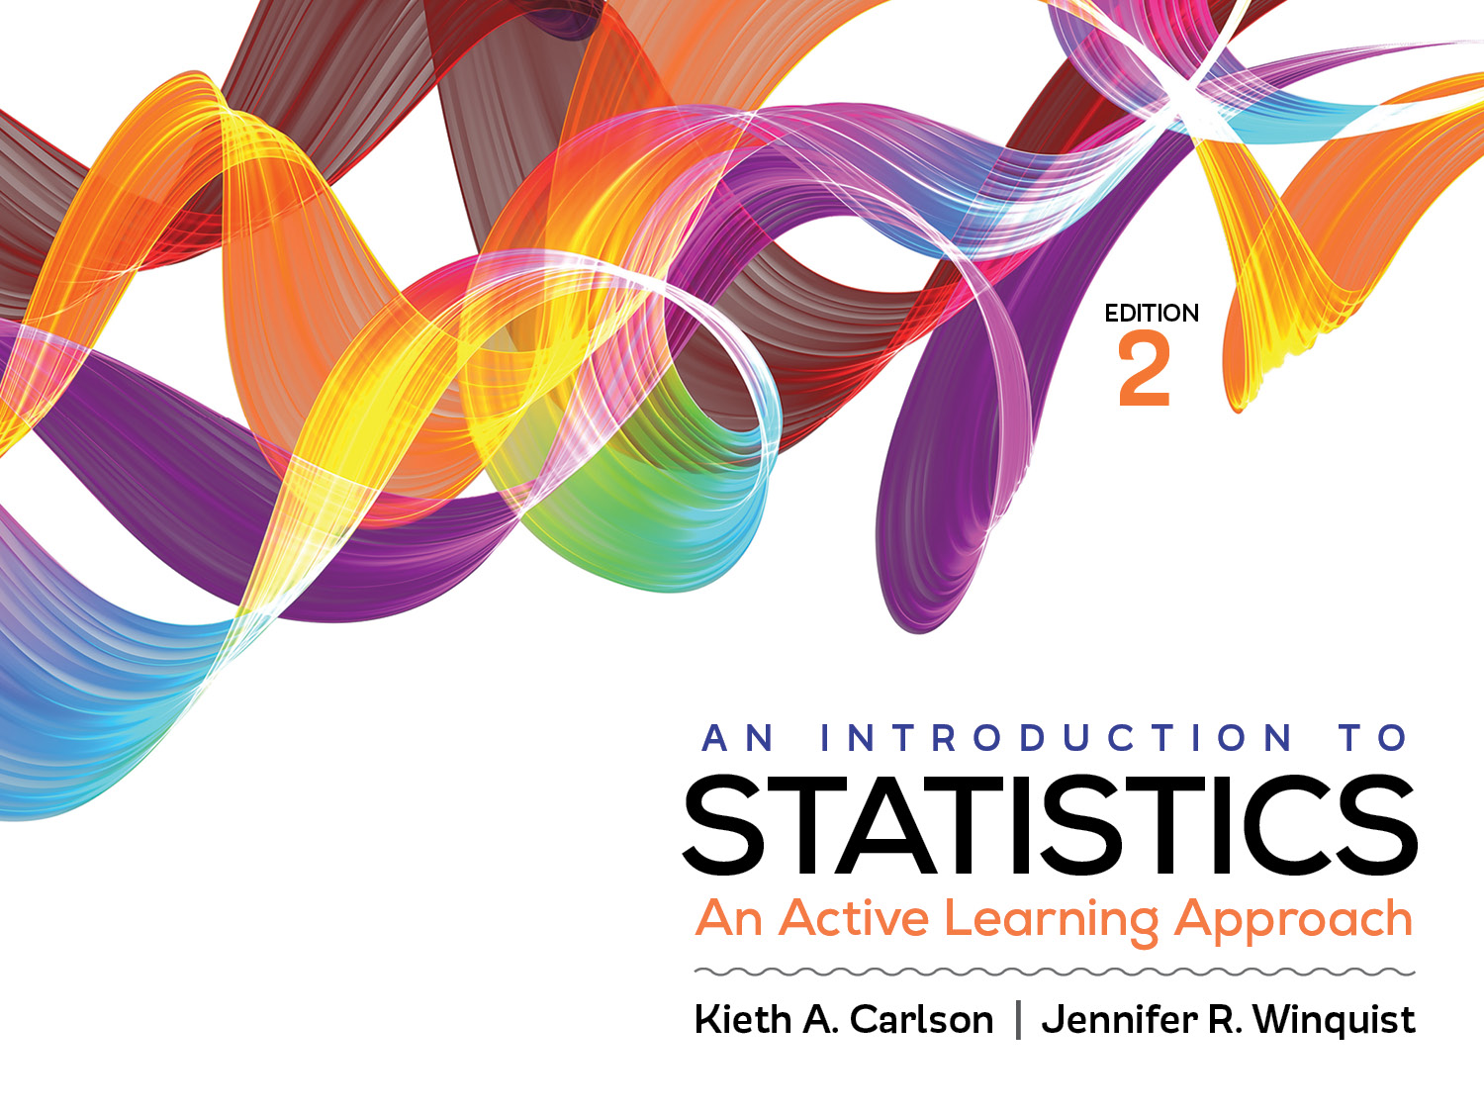
Introduction to Activity 10.4
Comparing independent, matched, and related research designs

Slide 2
Activity 10.4 will require you to:
Participate in 3 in class experiments the used three different research designs
Independent
Matched
Repeated
Compare the amount of sampling error created by each of these designs
Recognize the consequences of these differences on significance testing results

